Slide 1
‘Who? What? Where? When?’
History and Geography at Turnfurlong Infant School
Parent Involvement – February 4th 2020
Rebecca Ochiltree – Headteacher

Slide 2
Aims for this morning
To outline the ‘intent’ of our Humanities curriculum at TIS
To share our curriculum maps with you – where to find them on our school website
For you to spend time in classrooms experiencing teaching and learning alongside your children

Slide 3
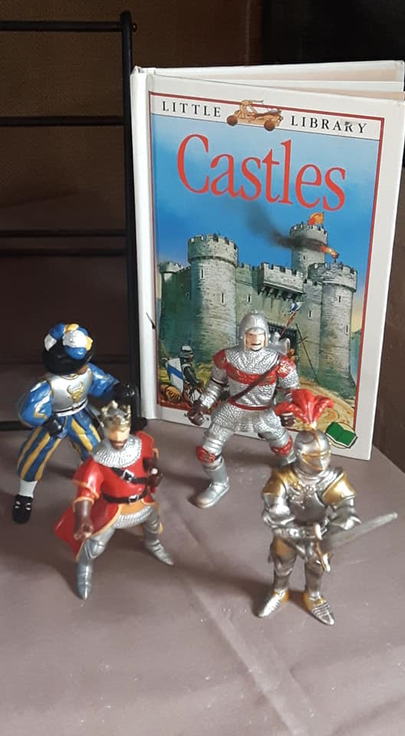
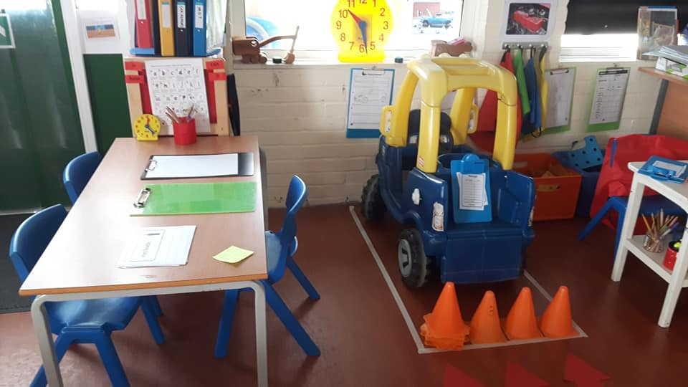
Turnfurlong Infant School
Early Years Foundation Stage: Nursery and Reception
Key Stage 1: Year 1 and Year 2

Slide 4
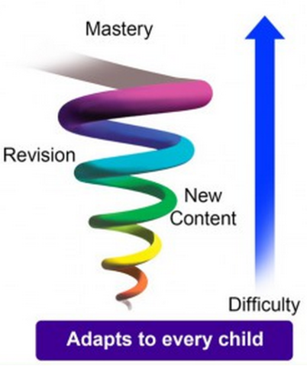

Stepping and spiralling
Notes:
Developing a sequence of learning from Nursery to end of Year 6, subjects are revisited

Slide 5

Communication and Language
Experiences at home and school
Making connections and comparisons
Developing specific subject vocabulary

Slide 6
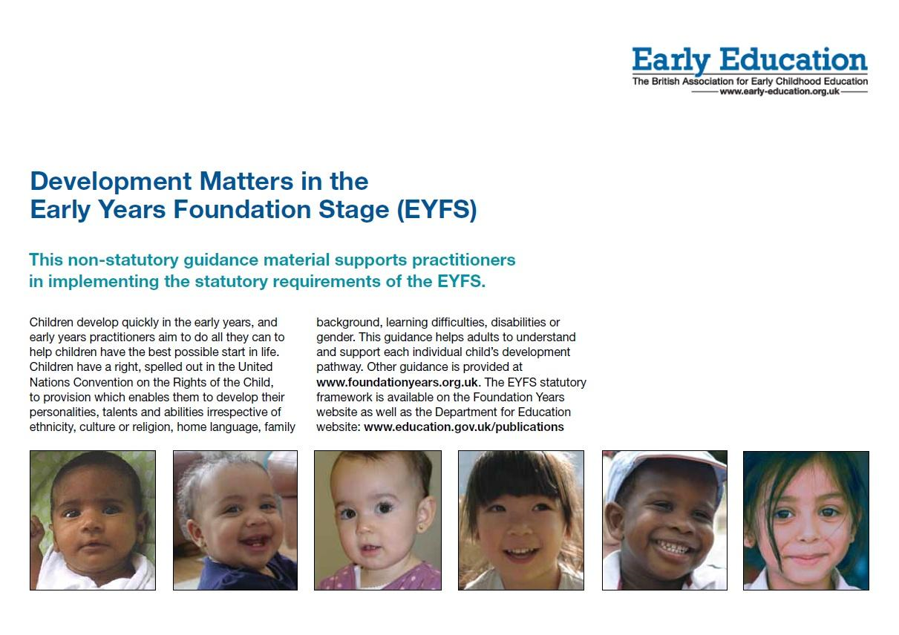
Early Years Foundation Stage: Nursery and Reception
Understanding of the World 1:
People and Communities
Understanding of the World 2:
The World

Slide 7

Key Stage 1: Year 1 and Year 2
National Curriculum programmes of study for History and Geography

Slide 8

Geography

Slide 9
We went on an aeroplane to visit my Nanny.
That’s my Tesco!
My community
Where I live (place knowledge)
My home
My family
Me
It’s a long car journey to my cousin’s house.
I live in Aylesbury
My friend’s family celebrates Eid. My family doesn’t.
My Mum is a nurse. She works at Stoke Mandeville.
Not everyone has a pet.
Early Years

Slide 10
Reception: Early Learning Goal
Children know about similarities and differences in relation to places, objects, materials and living things. They talk about the features of their own immediate environment and how environments might vary from one another.

Slide 11
Similarities and differences
Year 1
World map
Our school
Aylesbury
The UK
Kenya
Whitby
Maps of UK
Globes
Aerial photographs
Google maps
Maps of school
Seasonal weather patterns

Slide 12
Year 2
Following directions
Compass skills
Map skills
Rainforests
Continents and oceans
Arctic and Antarctic
Making own maps with keys
Atlas and globe
Physical features
Human features

Slide 13

History

Slide 14

My Grandad is a big number.
My family story.
Who came first?
What happened in my family before I was born?
What was it like when adults I know were children?
What does ‘old’ mean?
Me, my story and how I have changed
(change, cause and consequence)
Time is a really complex concept for young children to grasp!
Let me tell you the story of when…
First it’s my birthday, then it’s Mummy’s birthday and then it’s Christmas.
The order of my day, the order of special events within the year
(time, chronology)
When I was a baby I couldn’t walk.
Friday is treat day.

Slide 15
Reception: Early Learning Goal
Children talk about past and present events in their own lives and in the lives of family members. They know that other children don’t always enjoy the same things, and are sensitive to this. They know about similarities and differences between themselves and others, and among families, communities and traditions.

Slide 16
Significant historical figures and events in own locality
Changes within living memory
Me
Significant individuals who have contributed to national and international achievements.
History: Key Stage 1

Slide 17
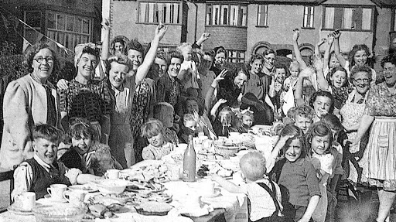
Learn about events beyond living memory that are historically significant globally or nationally.

Slide 18
Information on our school website
Our School
Curriculum Overview
https://www.turnfurlong-inf.bucks.sch.uk/page/?title=Curriculum+Overview&pid=36

Slide 19
Reception: Understanding of the World
Room 1: Place and the environment
Room 2: Past and present – remember when?
Room 3: Jobs some people do. What might I want to do when I grow up?
Outside: Following routes and plotting journeys

Slide 20
Key Stage 1
Year 1
Comparing and contrasting two localities; Aylesbury and places in Kenya.
Year 2
London then and now. 1666 and the Great Fire of London. Get stuck into making Tudor houses!

