Slide 1
Key Stage 1 SATS Workshop
Information about Year 2 SATS 2024/25

Slide 2
Changes to KS1 SATS
Assessments at the end of KS1 are now non-statutory.
The reception baseline assessment is now the baseline for measuring progress across the primary years.
Optional tests will be available to schools in April.

Slide 3
Why do we need to assess?
Assessment is a continuous part of teaching – checking in with children during a lesson, marking, observation, mini-tests (spellings)
We assess to find out what children know and what we need to do next
We reflect on whether we need to change something in our teaching

Slide 4
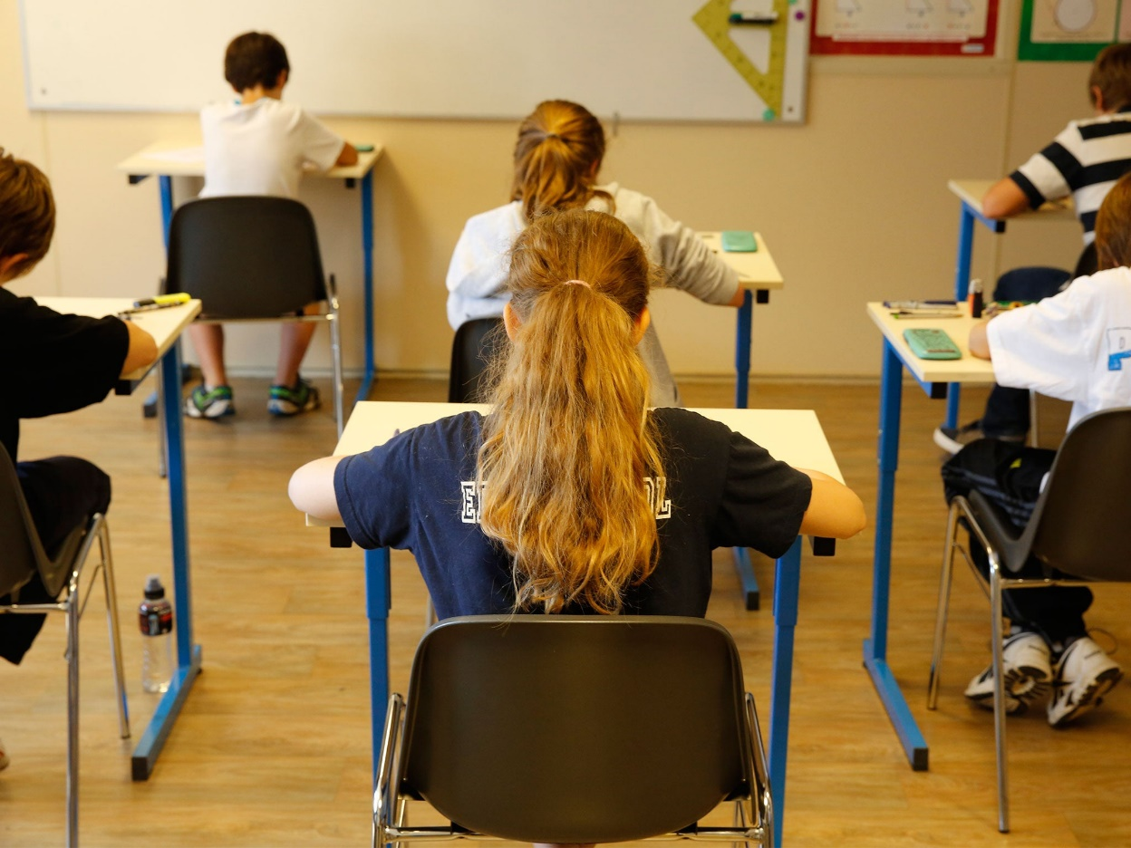
Why use SATs?
Children experience assessment as part of ‘day to day’ teaching and learning
Year 2 SATs combine papers in reading and maths with a standardised score with teacher assessments
Share individual assessment data with parents
Share this assessment data with junior schools
Year 2 SATs don’t look like this!

Slide 5
How do you know the results are accurate?
Teachers are very experienced in moderating (comparing, checking) their assessments with each other in school
Children’s progress and attainment is tracked across the year, and this is shared with parents at Parents Evenings
Analysis of progress and attainment of groups across the year shared strategically with governors
There is a local culture of ‘school to school’ moderation in Aylesbury (Early Years, KS1 and KS2)

Slide 6
What do you do with the results?
Able to compare our school with others in Buckinghamshire. How does attainment of different groups compare?
Able to identify trends over time. Linked to School Improvement Planning.
Able to make informed adjustments to teaching, learning and the curriculum. Linked to School Improvement Planning.

Slide 7
Assessment and Reporting
Our Year 2 children will be assessed in reading, writing, grammar, punctuation and spelling and maths.
The tests are one way to inform teacher assessment, as in previous years.
Teacher assessment, not test results, will form part of the data passed on to your child’s next school/teacher.
There is no requirement to report results to the local authority or parents. However, you will receive an end of year report detailing the attainment and progress of your child, including the marks they scored in each test.
Internal moderation occurs regularly to ensure consistency of data.

Slide 8




The Tests
At the end of Year 2, children will take tests in:
Reading;
English grammar, punctuation and spelling;
Maths.
The tests are due to take place in May. There are no set days for these.

Slide 9
Reading
The Reading Test consists of two separate papers:
Paper 1 – Contains a selection of texts. Texts and questions are together in one booklet.
Paper 2 – Contains a reading booklet of a selection of passages. Children will write their answers to questions about the passage in a separate booklet.
Each paper is worth 50% of the marks and should take approximately 30 to 40 minutes to complete, however, these are not timed tests.
The texts will cover a range of poetry, fiction and non-fiction.
Questions are designed to assess the comprehension and understanding of a child’s reading.
Some questions are multiple choice, others require short answers and some require an extended response or explanation.

Slide 10

There are a variety of question types:
Multiple choice
Ranking/ordering, e.g. ‘Number the events below to show in which order they happened in the story’
Matching, e.g. ‘Match the character to the job that they do in the story’
Labelling, e.g. ‘Label the text to show the title’
Find and copy, e.g. ‘Find and copy one word that shows what the weather was like in the story’
Short answer, e.g. ‘What does the bear eat?’
Open-ended answer, e.g. ‘Why did Lucy write the letter to her grandmother? Give two reasons’
Teachers have the option to stop the test at any point that they feel is appropriate for a particular child.

Slide 11
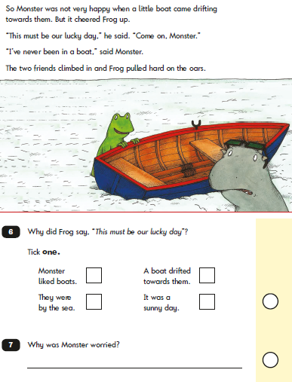

Slide 12
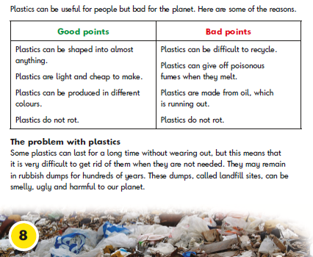

Slide 13
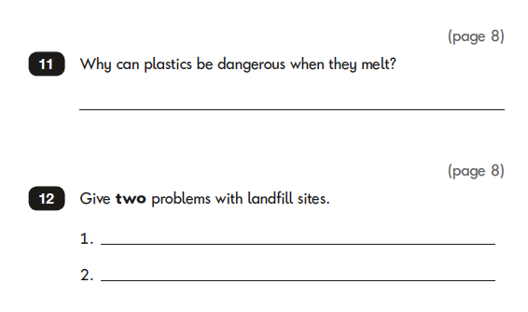

Slide 14


Writing
There are no tests for writing
Writing - a range of genres – fiction and non-fiction
Writing is assessed against a set of standards – Working Towards the Expected Standard, Working at the Expected Standard and Working at Greater Depth.

Slide 15
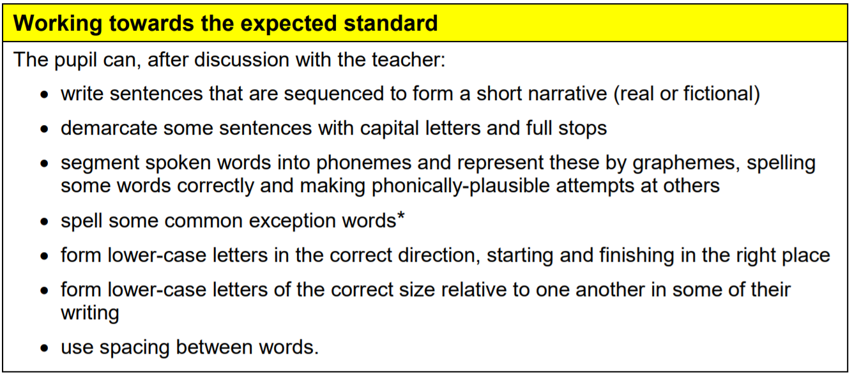

Slide 16
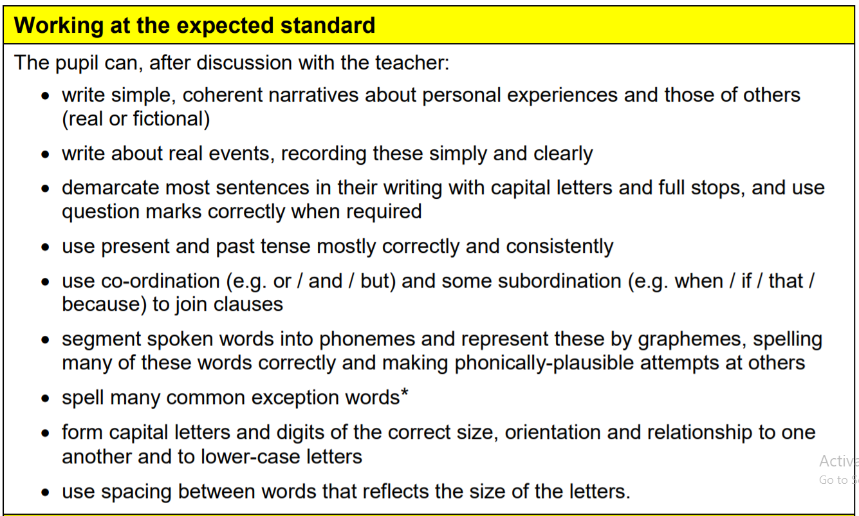

Slide 17
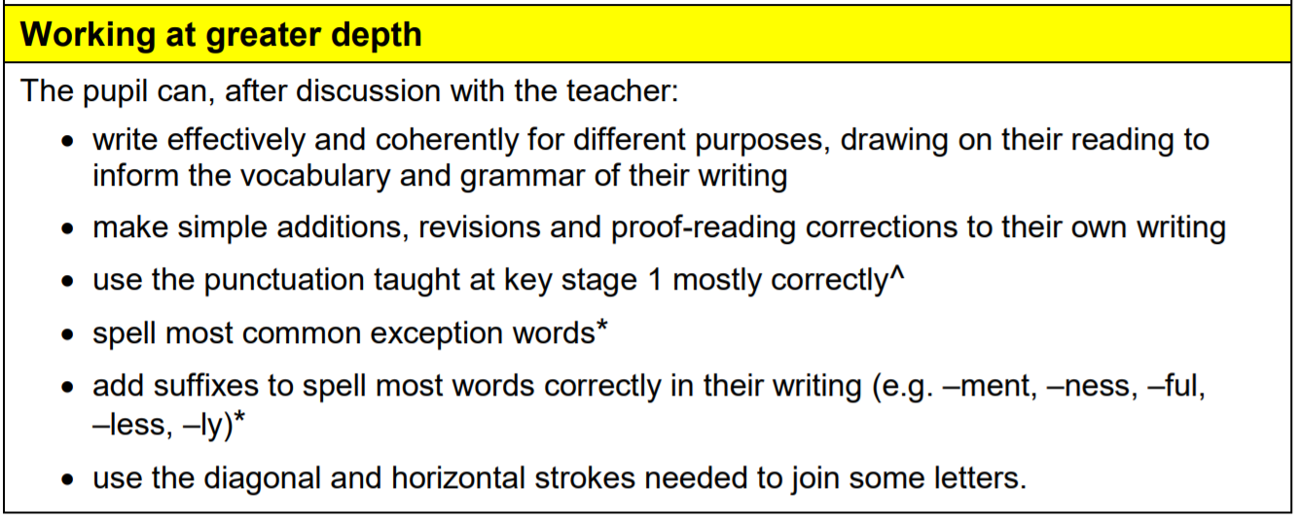

Slide 18

Spelling, Punctuation and Grammar
The test consists of two separate papers:
Paper 1: spelling (20 marks).
Paper 2: questions (20 marks).
It is expected that these will take 15
to 20 minutes per paper.

Slide 19
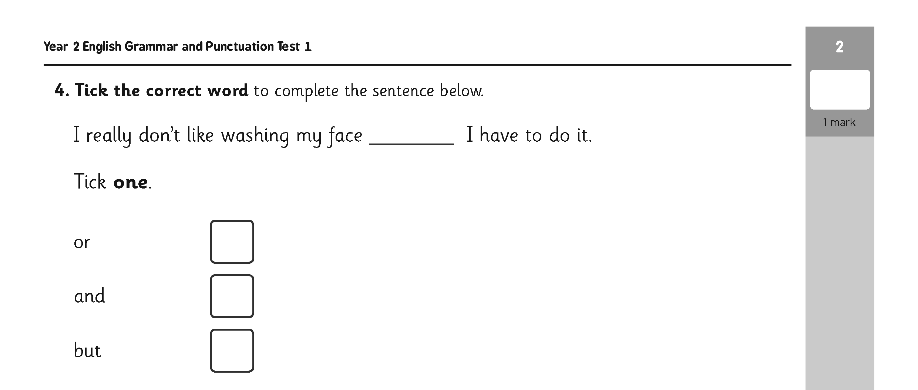

Slide 20
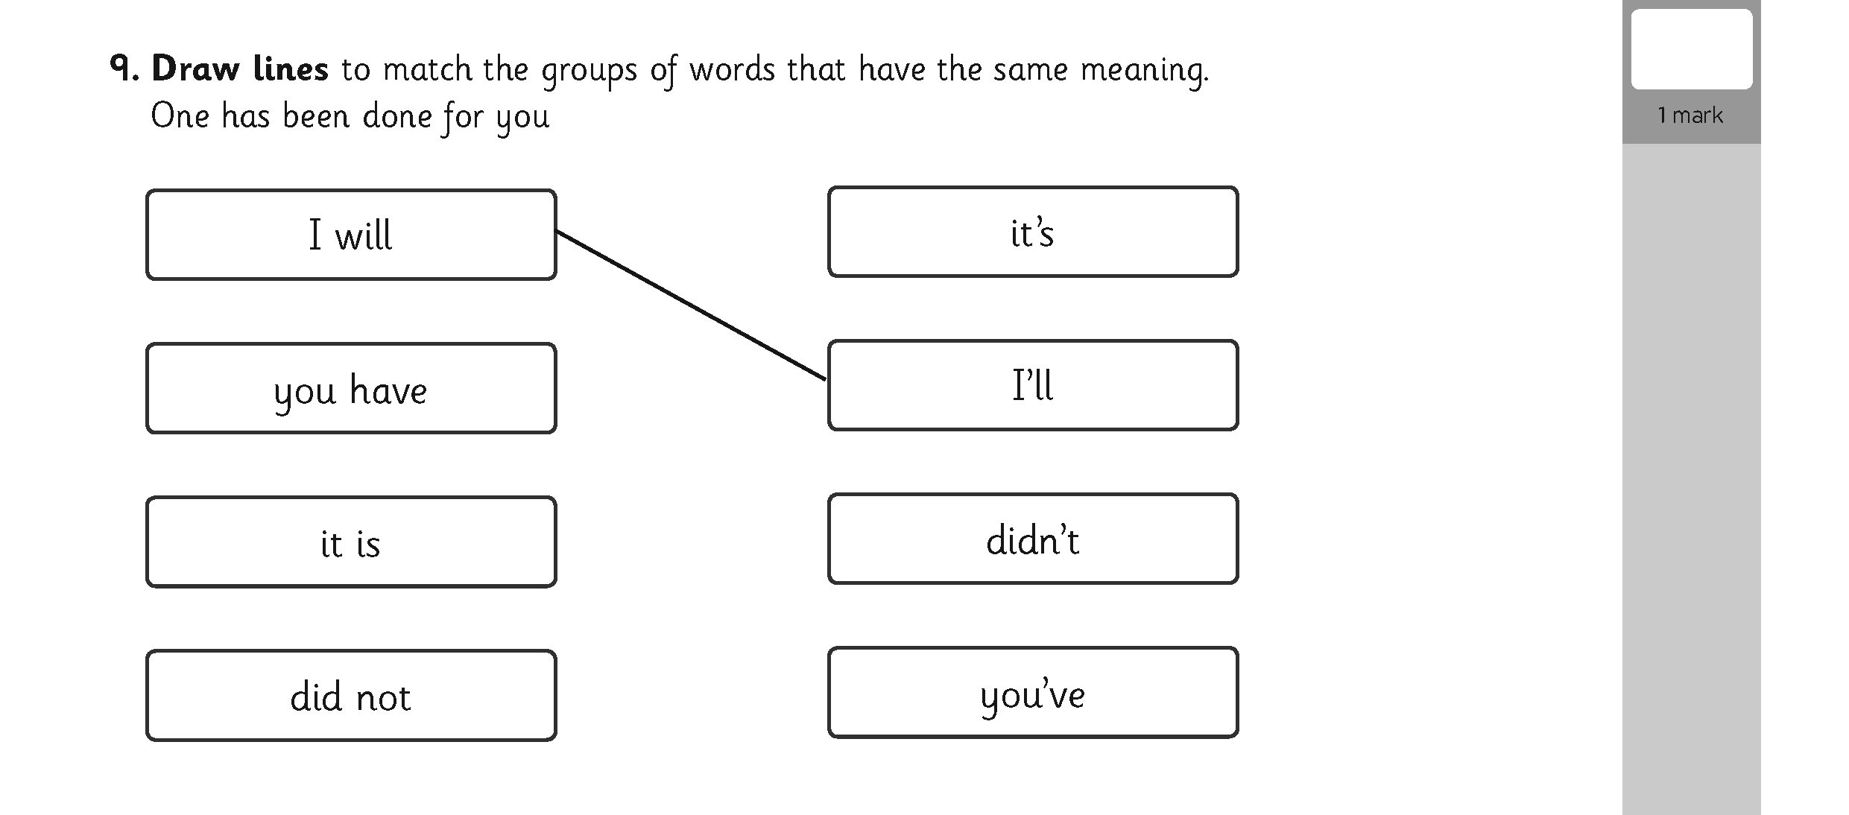

Slide 21



Mathematics
Children will sit two tests: Paper 1 and Paper 2:
Paper 1 is for arithmetic, lasting approximately 20/25 minutes and worth 25 marks. It covers calculation methods for all operations.
Paper 2 covers problem solving, reasoning and mathematical fluency, lasts for approximately 35 minutes and is worth 35 marks. This paper includes some (5) mental maths questions.

Slide 22
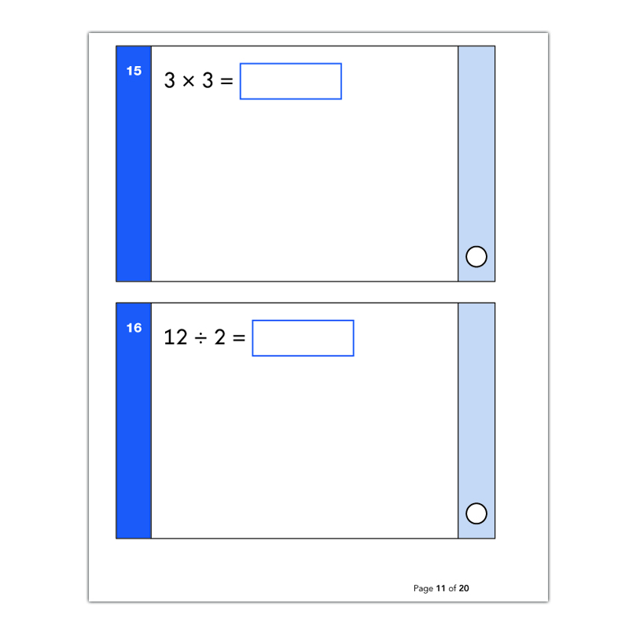
Maths Paper 1: Arithmetic

Slide 23
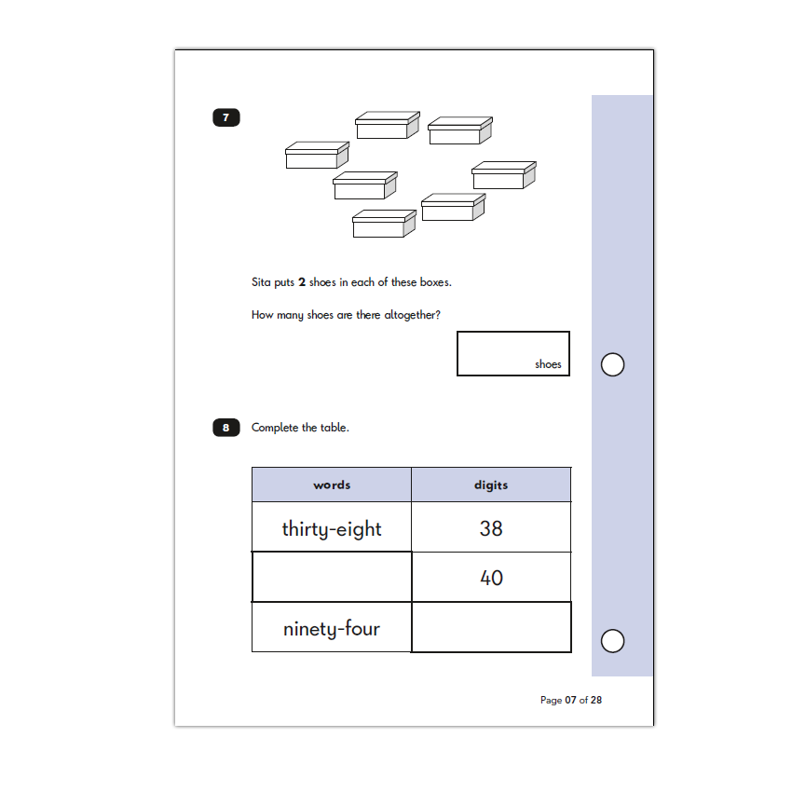
Maths Paper 2: Reasoning

Slide 24

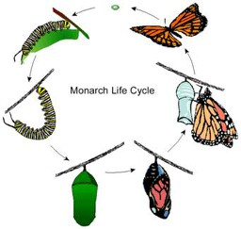
Science
As with writing there is no science test.
Science is assessed through the year against a framework.
Children need to meet all criteria in order to be judged as having met the standards.

Slide 25
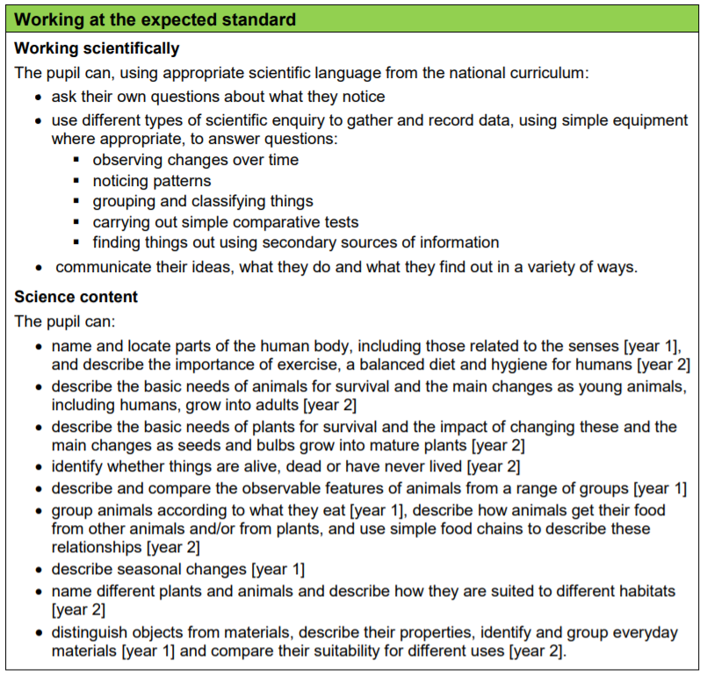

Slide 26
How will the tests be marked?
Although the tests are set externally, they are marked by teachers within the school.
Children are given a scaled score. Their raw score – the actual number of marks they get – is translated into a scaled score, where a score of 100 means the child is working at the expected standard.
A score below 100 indicates that the child needs more support, whereas a score of above 100 suggests the child is working at a higher level than expected for their age. The maximum score possible is 115, and the minimum is 85.
However, the test results are only a small part of what teachers use to assess each child. The work that they complete throughout the year is also taken into account.

Slide 27
When will the KS1 SATs take place?
The KS1 Optional SATs are due to be administered in May 2025.
Unlike KS2 SATs, KS1 SATs don't have to be administered according to a nationally-set timetable in a specific week. Schools are free to manage the timetable and will aim to administer the tests in the classroom in a low-stress, low-key way; some children won't even be aware they've taken them!

Slide 28
What can you do to help your child?
Keep on doing what you are doing!
Continue sharing and reading books at home.
Practise weekly spellings and encourage your child to use the words in sentences.
Support your child with homework activities.
Practise times tables.
Get practical! Weigh and measure out ingredients when baking, count pocket money, play Snakes and Ladders, go on a creepy crawlie hunt, share biscuits into equal groups, count the stairs to bed in 2s, 5s, 10s, etc. The possibilities are endless!

Slide 29

Remember!
Year 2 SATs are a snapshot of achievement at a point of time
No employer will ask you if you were ‘working at’ or ‘exceeding’ at the end of Year 2
Year 2 SATs are a measure of attainment, not progress
A child may be ‘working towards’ or ‘working at’ but made really good progress!

