Slide 1
Parent Involvement Morning Nov 23
STAYING SAFE

Slide 2
Today……
This term’s Parent Involvement morning has a focus on Relationships and Health Education (RHE) and Safeguarding. We teach children how to keep themselves safe in a variety of contexts and situations across the year, including how to safe online.
Today we aim to tell you more about how we teach these essential life skills at Turnfurlong Infant School and then spend time in the classrooms learning alongside your child.

Slide 3
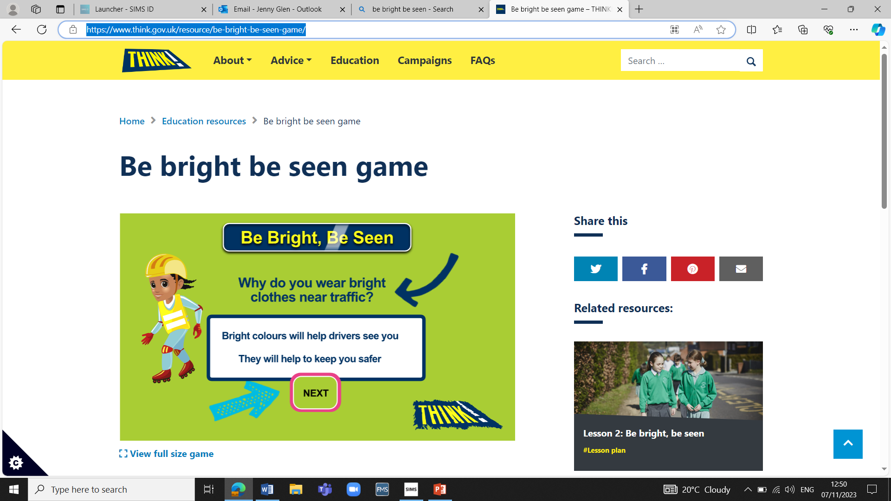
Road Safety
National road safety week
https://www.think.gov.uk/key_stage/ks1/
Be bright be seen game – THINK!
Think! Hedgehog Road Safety-King of the Road (1998) - YouTube
Hedgehog song -THINK road saftey advert- - YouTube
Activities based on the green cross code and car safety – wearing a seatbelt, booster chairs and wearing a cycle helmet

Slide 4
Parking
Have you signed up to our PARENT PARKING PROMISE????
We appreciate many people need to drive to school to be able to get to work after drop off or live out of catchment but please -
Parking considerately outside school – not blocking residents driveways or car park entrances
No 3 point turns on the road outside school in heavy congestion
No mounting the kerb or grass verges for parking or turning

Slide 5
First aid
First Aid https://firstaidchampions.redcross.org.uk/en/primary/safety/
Medicine safety studied in Y2 as part of the Science curriculum as part of ‘Keeping Healthy’ topic
Activities involving spotting dangers around the home – trailing cables, plug sockets, open windows, falls from height e.g. bunk beds, candles, water on the floor, hot irons and hot drinks.

Slide 6
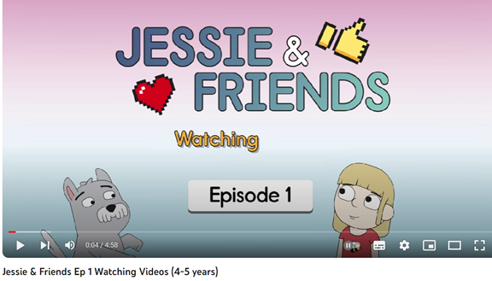
Online safety
Internet Safety https://saferinternet.org.uk/guide-and-resource/young-people/resources-for-3-11s
Jessie & Friends Ep 1 Watching Videos (4-5 years) – YouTube
In school we use - Zip it, block it, flag it!
The children are very well versed in this – ask
them what it means…

Slide 7
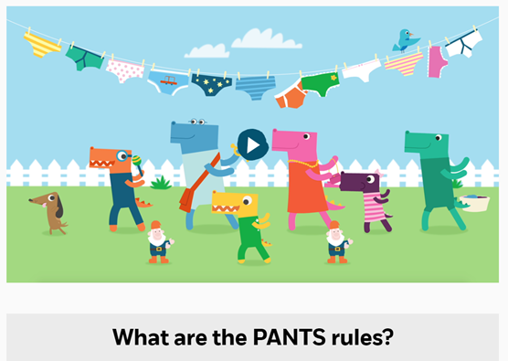
Personal safety
NSPCC pants programme - Let's talk PANTS | NSPCC
                We revisit this annually!
                Activities today focusing on staying safe out and about e.g. Bonfire night gatherings, around the canal and water sources

Slide 8
Stranger danger!
What is a stranger?
Who are trusted adults?
Who can your child talk to if they are worried?

Slide 9
Did you know we have a School Travel Plan (STP)?
Lots of initiatives to tick off within the school curriculum
Consultations held with different school stakeholders e.g. staff, parents, school council, residents, local council, TVP
Includes reducing air pollution around schools and using more public transport
A good reason to get visitors in – fire, police, PCSO, school crossing patrol, GIST heavy goods vehicles, JRSO’s from TJS

Slide 10

PLATINUM!!
Thank you to everyone who has walked, cycled or scootered to school.
Numbers of those car sharing or using the ‘Park and Stride’ routine has increased over the last 5 years.
We have been nominated for the Bucks Modeshift award again this year – we find out this afternoon if we have won!!! Watch this space…..

Slide 11


